Slide 1



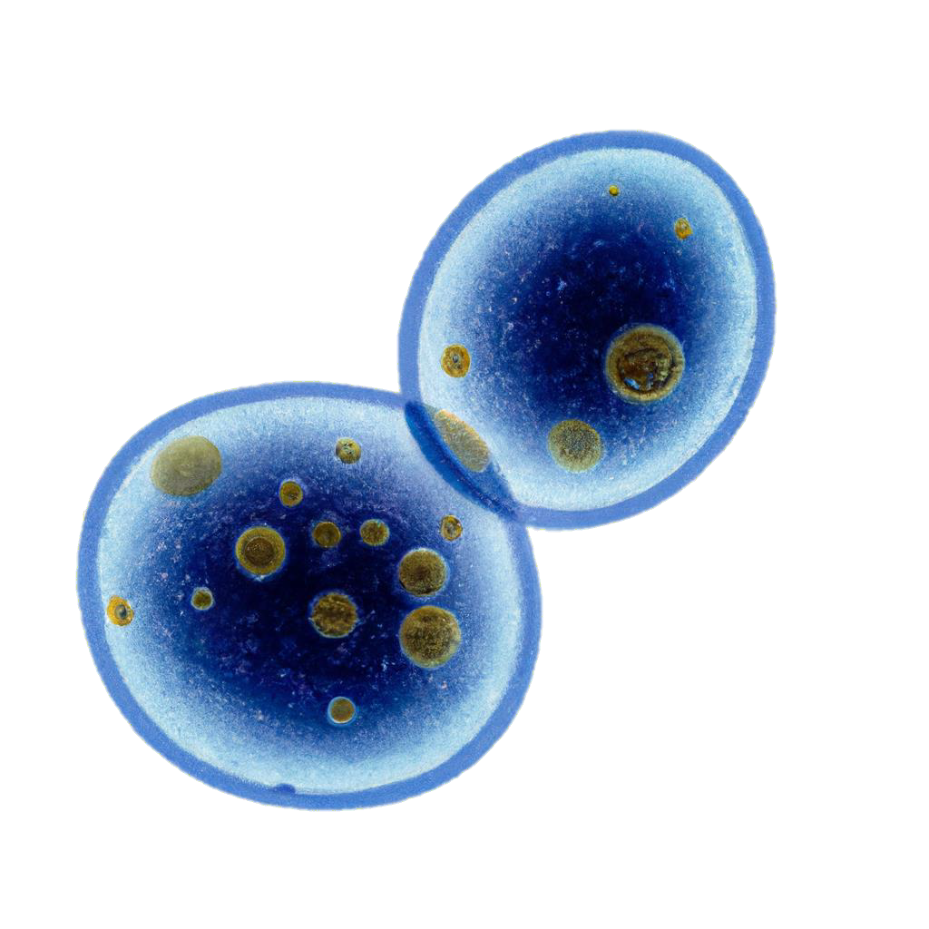

Unravelling Sex-Specific Aging on Flies: A Deep Learning Approach – Age Update
Presented by Nikolai Tennant,
Researcher at Ritambhara Singh's Lab
Brown University & IISAGE

Slide 2
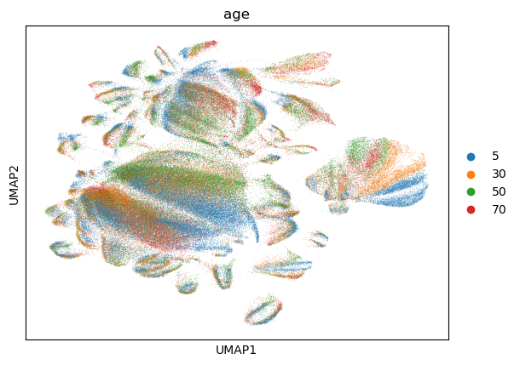
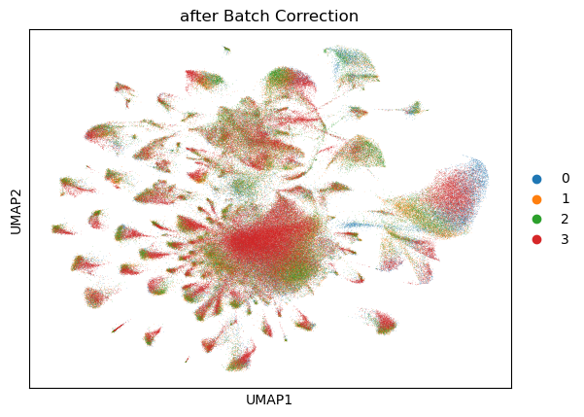
AGE UMAP: Raw vs. Batch Corrected
Before Batch Correction

Slide 3

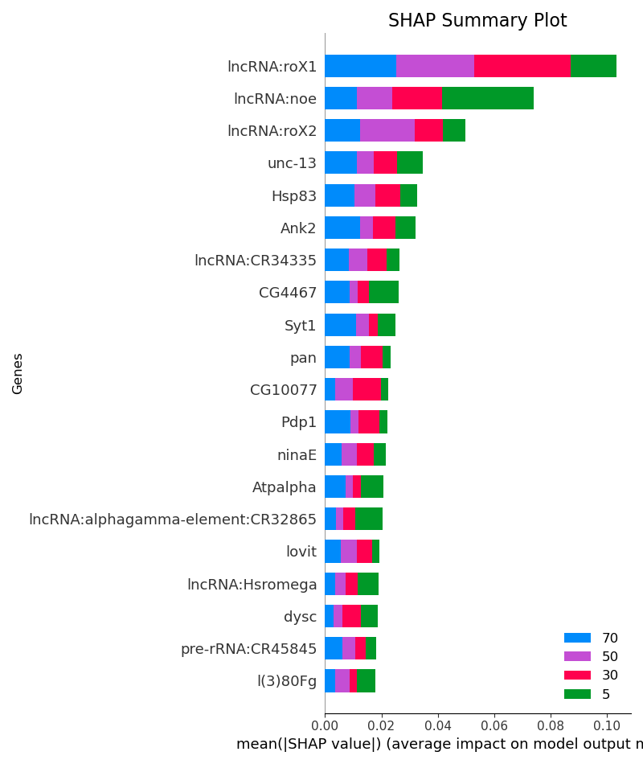
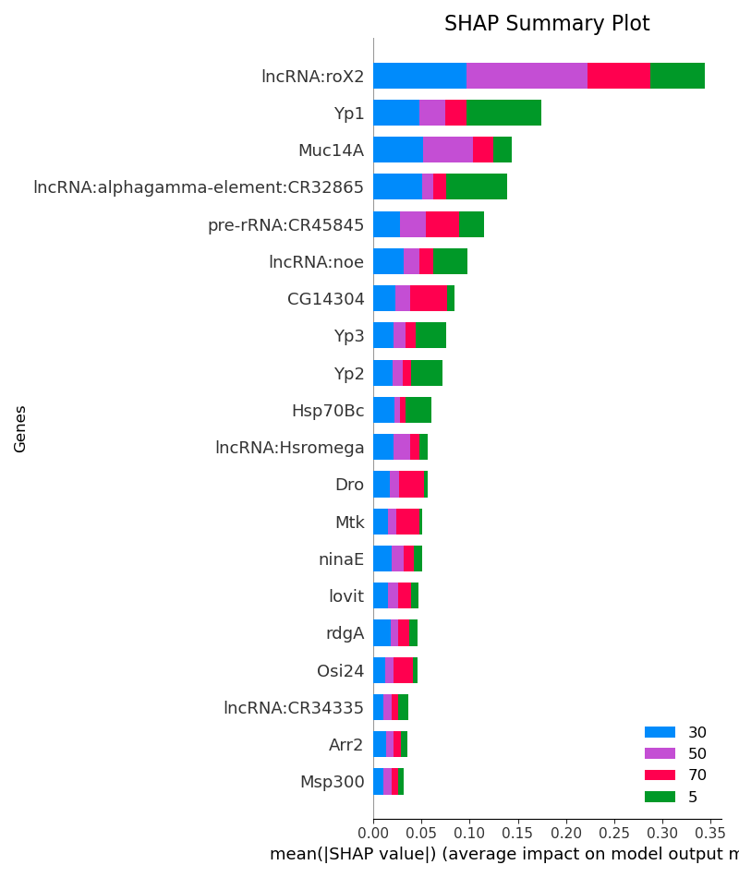
AGE – All Cell Types (Head): Raw vs Batch
{
"Test": {
"Accuracy": "93.79%",
"Precision": "93.27%",
"Recall": "93.34%",
"F1": "93.27%",
"AUC": "99.46%"
},
"Baseline": {
"Accuracy": "33.67%",
"Precision": "8.42%",
"Recall": "25.00%",
"F1": "12.59%"
}
}
{
"Test": {
"Accuracy": "89.17%",
"Precision": "88.22%",
"Recall": "88.27%",
"F1": "88.24%",
"AUC": "98.35%"
},
"Baseline": {
"Accuracy": "33.78%",
"Precision": "8.44%",
"Recall": "25.00%",
"F1": "12.62%"
}
}
Figure 2: Raw Age - Tested with all 16K genes
Figure 3: Batch Corrected Age - Tested with only top 5000 most variable genes (does not include roX1)
– Performance decrease due to smaller gene pool, not batch correction

Slide 4
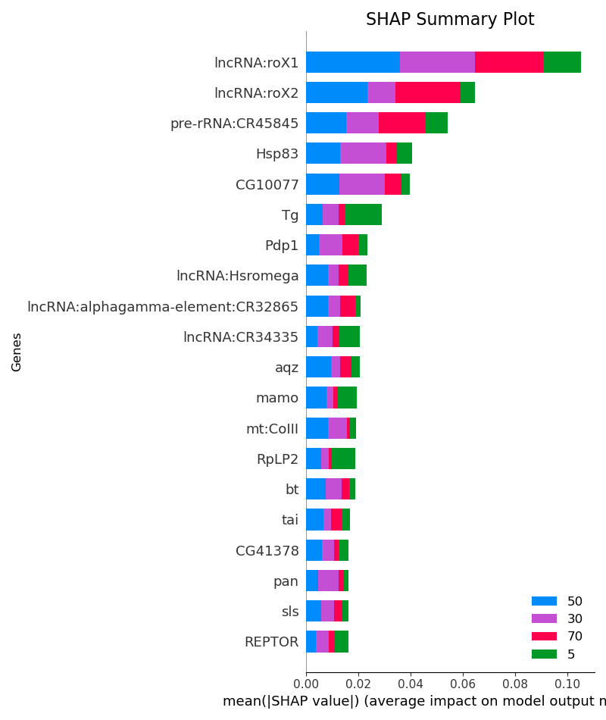
AGE – All Cell Types (Body)
Figure ? : Age SHAP Summary Plot – All Body Genes (ACC: 94%, AUC: 99.3)
Figure ? : Age SHAP Summary Plot –
Trained on Body cells and tested on Head Cells (ACC: %, AUC: ?)
Figure ? : Age SHAP Summary Plot –
Trained on Head cells and tested on Body Cells (ACC: %, AUC: ?)

Slide 5
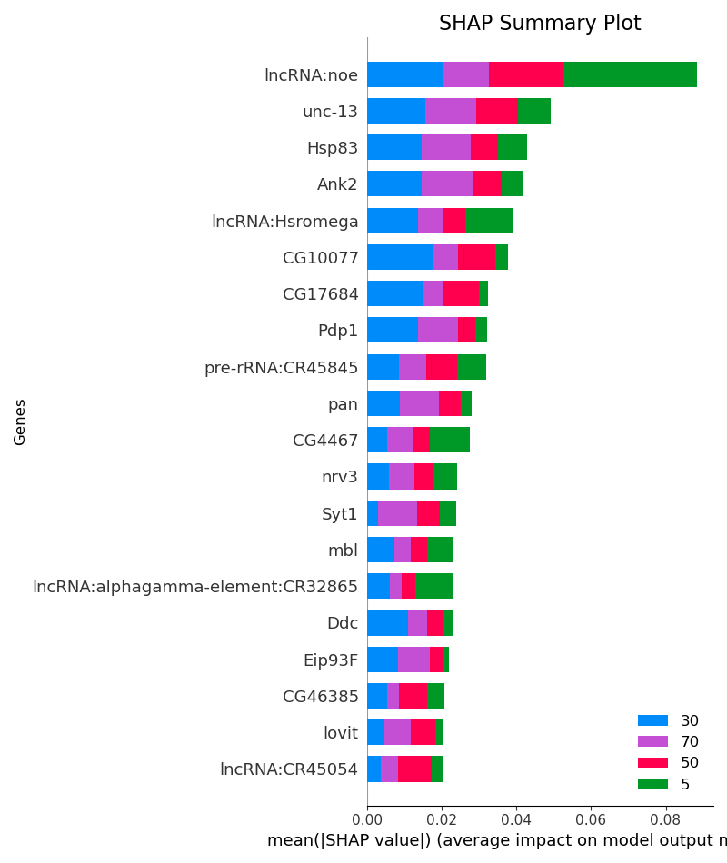
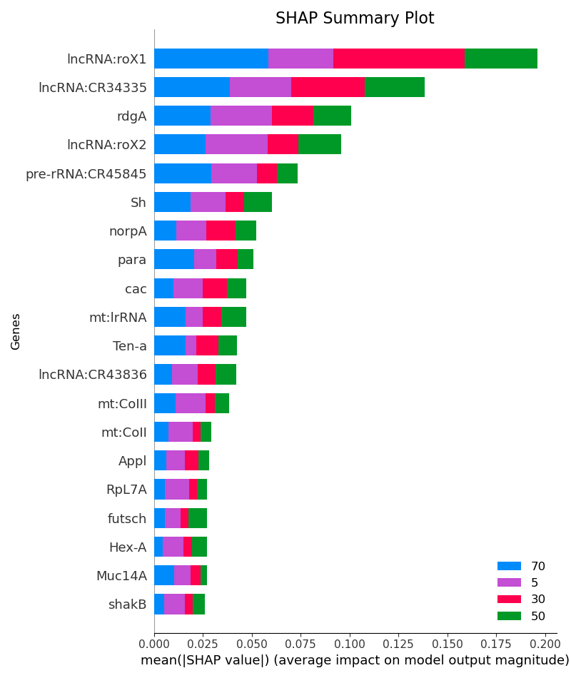
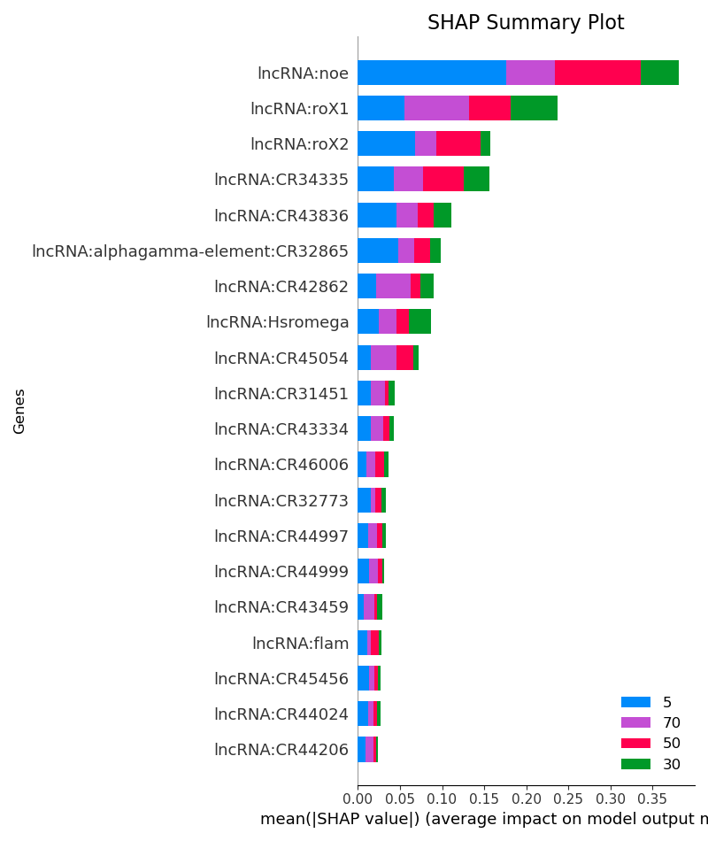
AGE – All Cells (Head)
Figure 3 : Age SHAP Summary Plot – All Genes (ACC: 94%, AUC: 0.99)
Figure 4: Age SHAP Summary Plot – Only Autosomal Genes (ACC: 92%, AUC: 0.99)
Figure 5 : Age SHAP Summary Plot – Only Sex Genes (ACC: 84%, AUC: 0.96)
Figure 6 : Age SHAP Summary Plot – Only LNC Genes (ACC: 70%, AUC: 0.91)

Slide 6
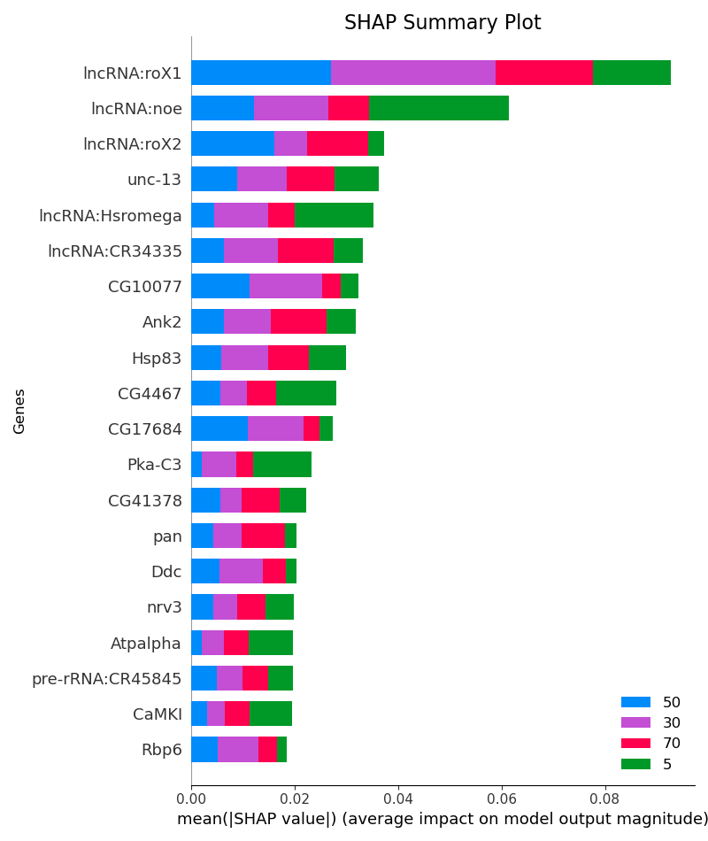
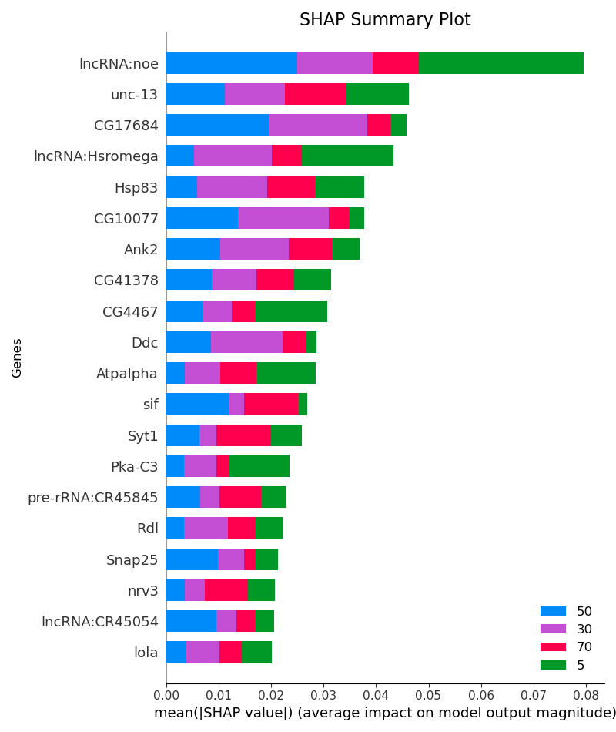
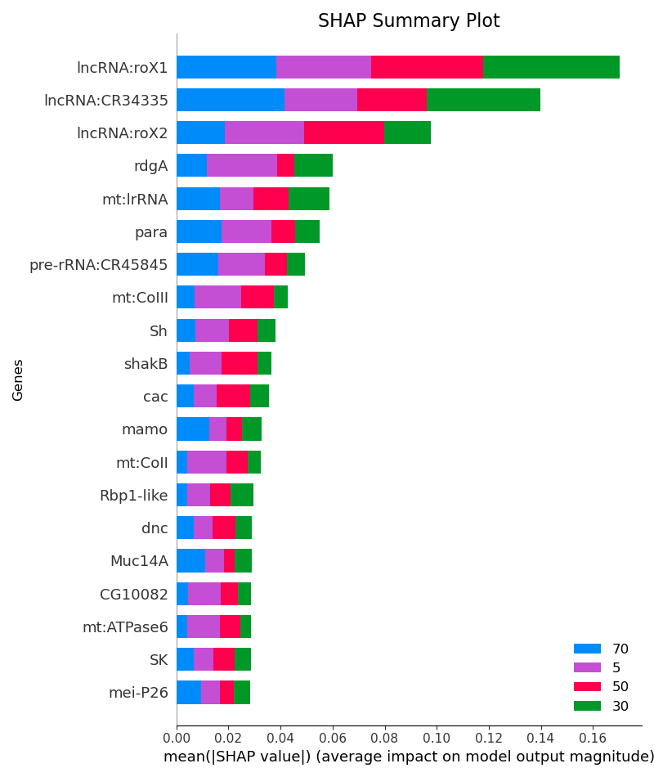
AGE – CNS Neurons (Head)
Figure 7 : Age SHAP Summary Plot – All Genes (ACC: 94%, AUC: 0.99 )
Figure 8 : Age SHAP Summary Plot – Only Autosomal Genes (ACC: 92%, AUC: 0.99)
Figure 9: Age SHAP Summary Plot – Only Sex Genes (ACC: 84%, AUC: 0.97)

Slide 7
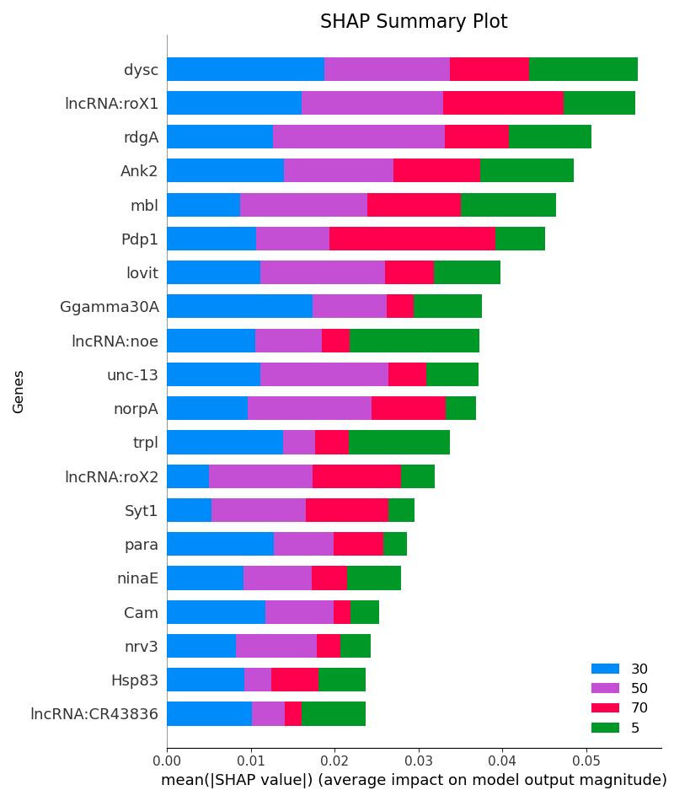
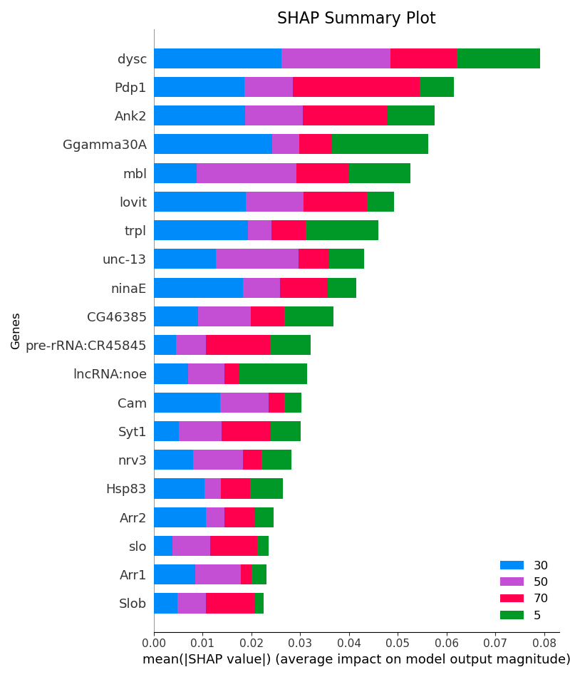
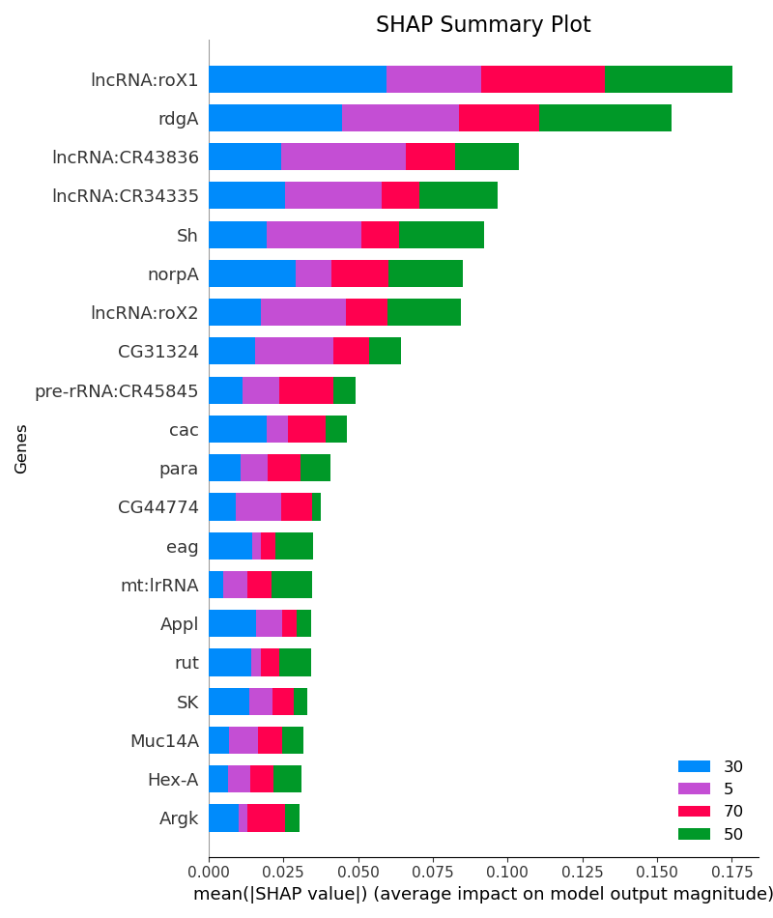
AGE - Sensory Neurons (Head)
Figure 10 : Age SHAP Summary Plot – All Genes (ACC: 94%, AUC: 0.99)
Figure 11 : Age SHAP Summary Plot – Only Autosomal Genes (ACC: 92%, AUC: 0.99)
Figure 12 : Age SHAP Summary Plot – Only Sex Genes (ACC: 86%, AUC: 0.97)

Slide 8
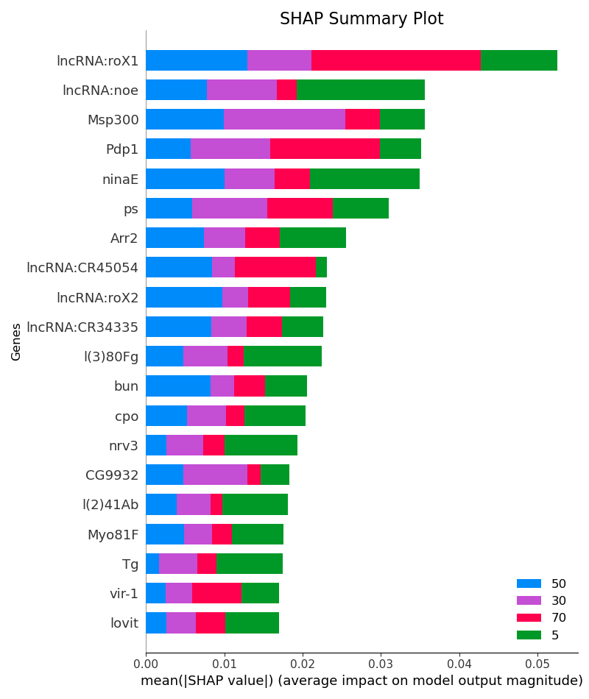
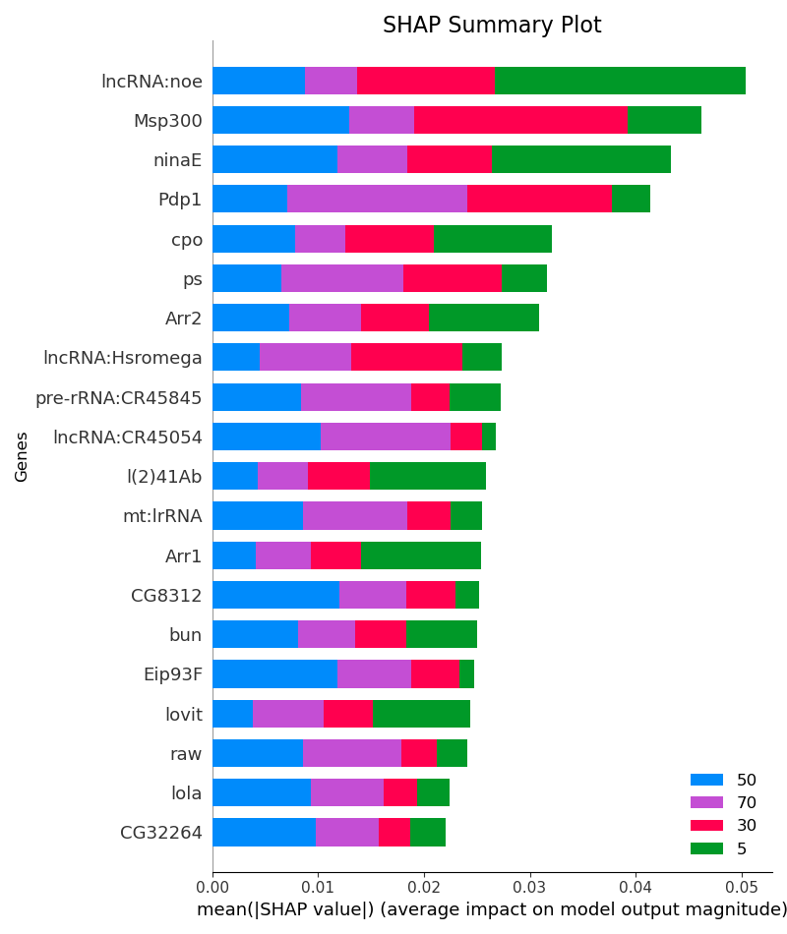
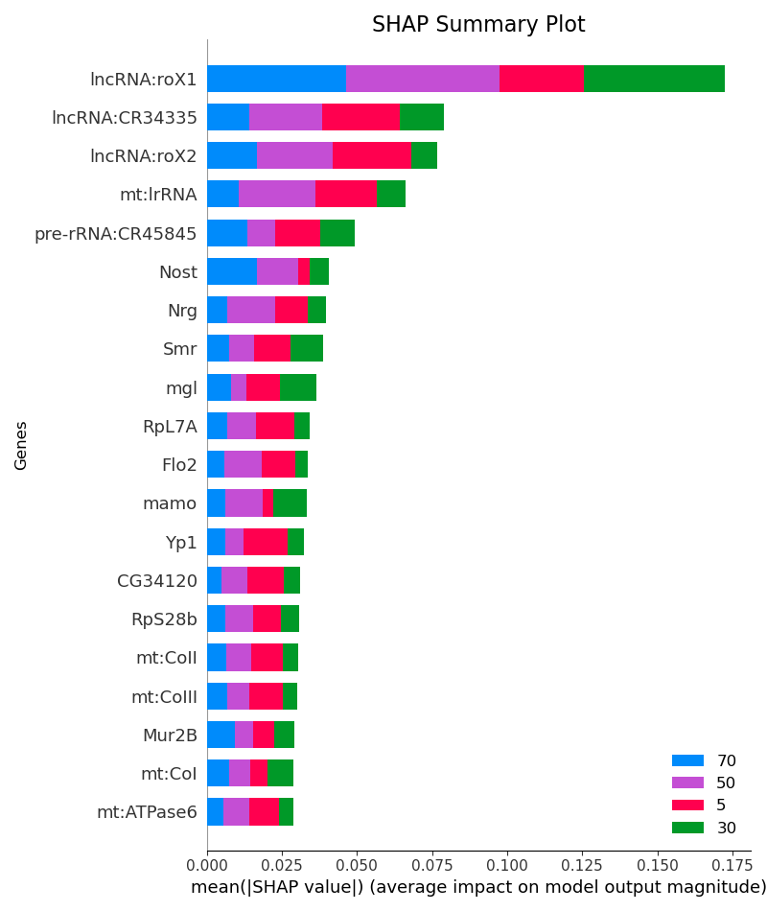
AGE – Epithelial Cells (Head)
Figure 13 : Age SHAP Summary Plot – All Genes (ACC: 92%, AUC: 0.99)
Figure 14 : Age SHAP Summary Plot – Only Autosomal Genes (ACC: 89%, AUC: 0.98)
Figure 15 : Age SHAP Summary Plot – Only Sex Genes (ACC: 81%, AUC: 0.95)

Slide 9
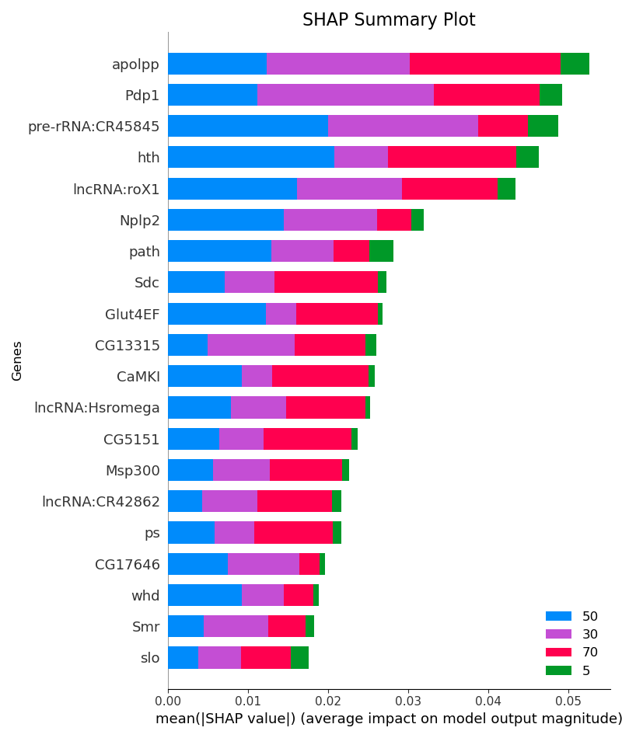
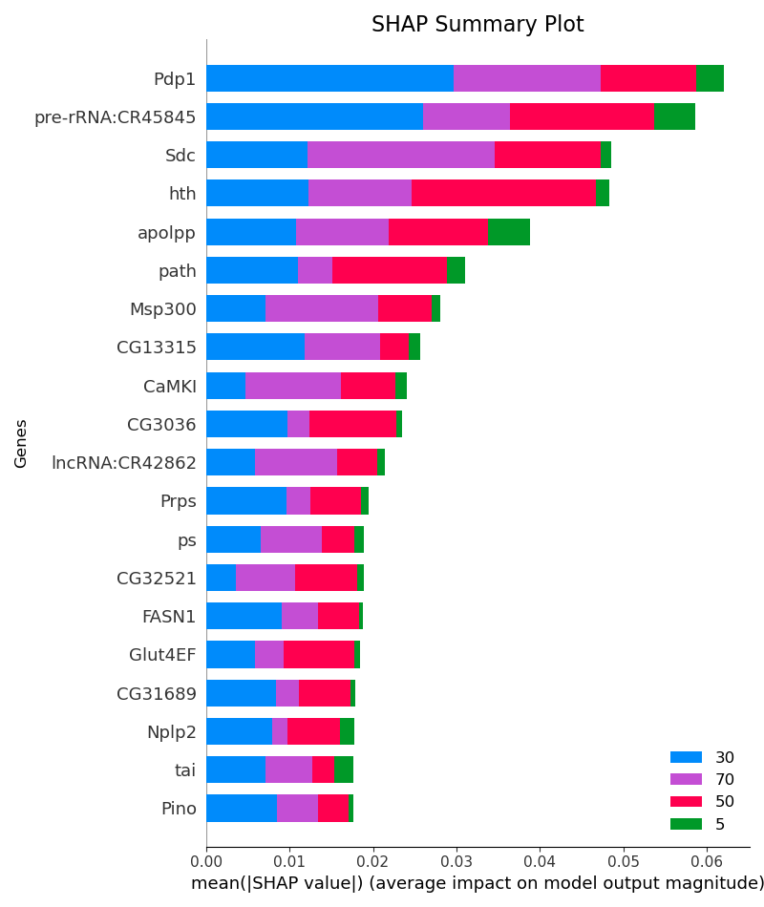
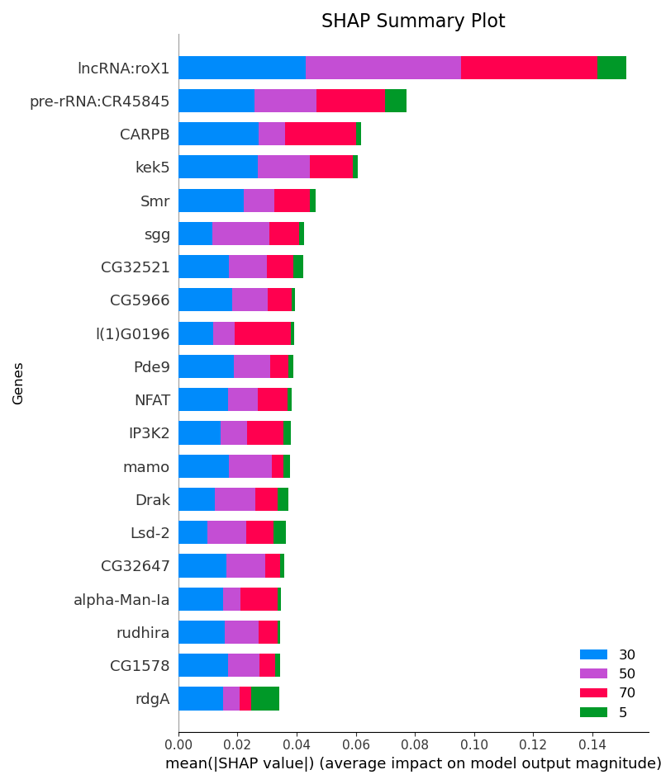
AGE – Fat Cells (Head)
Figure 16 : Age SHAP Summary Plot – All Genes (ACC: 95%, AUC: 1.0)
Figure 17 : Age SHAP Summary Plot – Only Autosomal Genes (ACC: 94%, AUC: 1.0)
Figure 18 : Age SHAP Summary Plot – Only Sex Genes (ACC: 85%, AUC: 0.98)

Slide 10
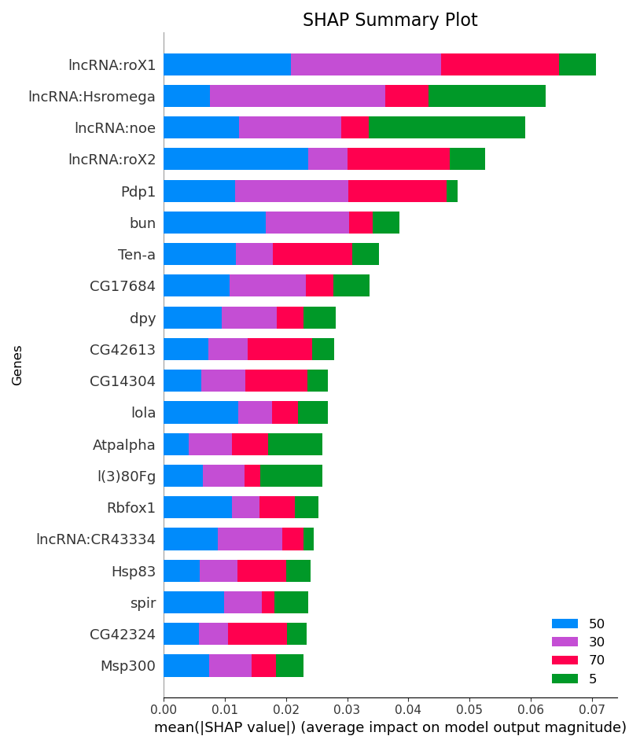
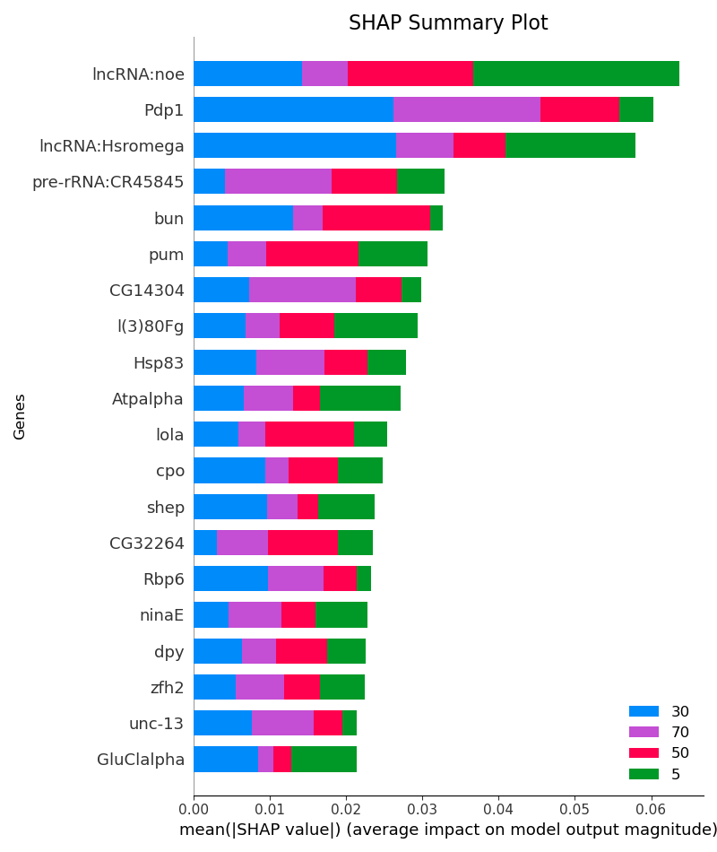
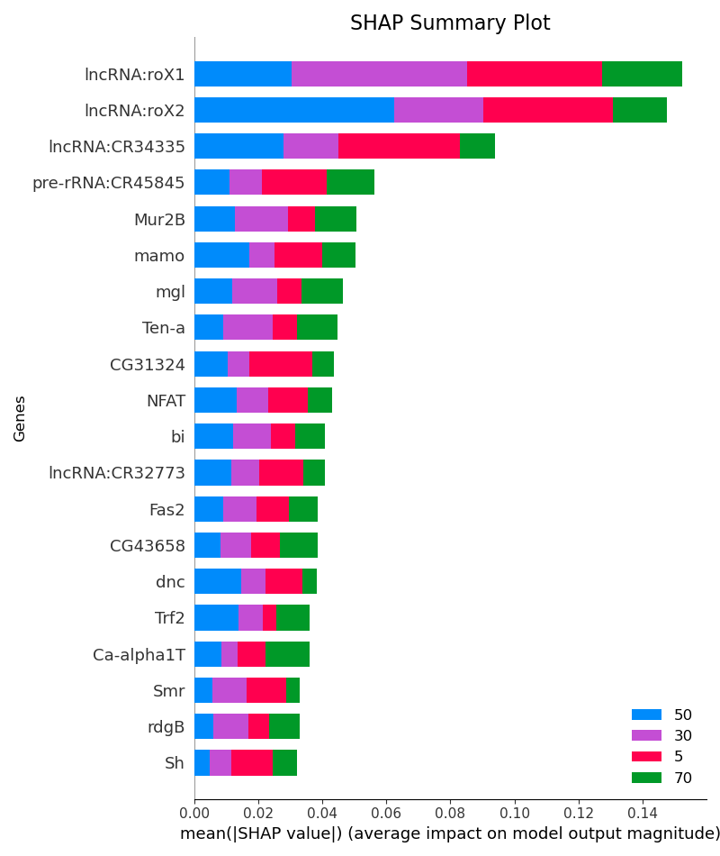
AGE – Glial Cells (Head)
Figure 19 : Age SHAP Summary Plot – All Genes (ACC: 91%, AUC: 0.98)
Figure 20: Age SHAP Summary Plot – Only Autosomal Genes (ACC: 89%, AUC: 0.97)
Figure 21 : Age SHAP Summary Plot – Only Sex Genes (ACC: 76%, AUC: 0.93)

Slide 11
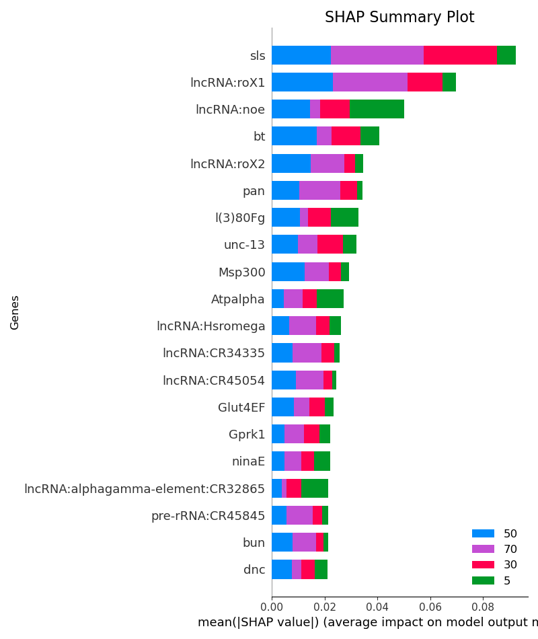
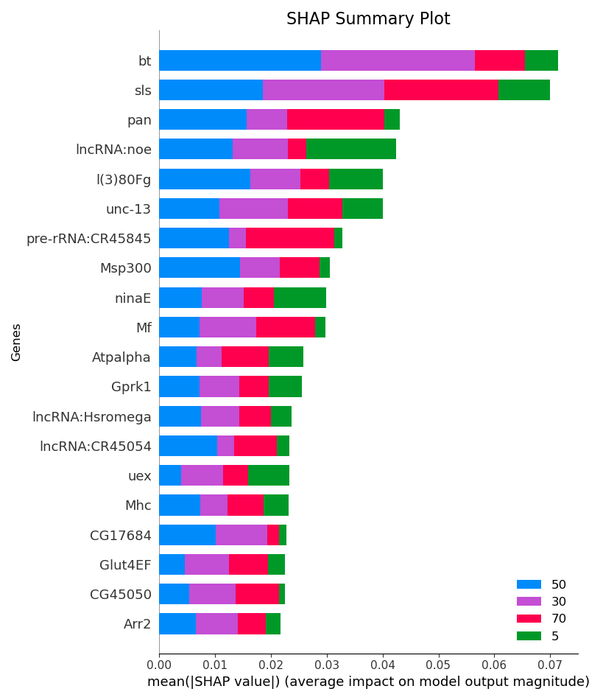
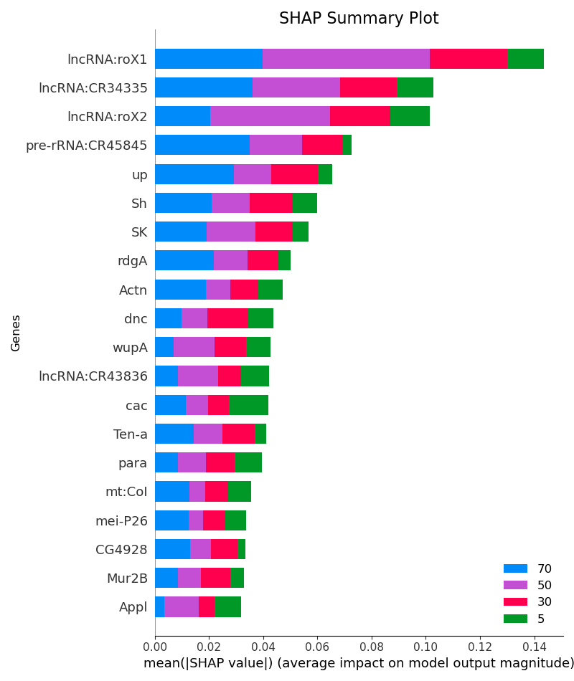
AGE – Muscle Cells (Head)
Figure 22 : Age SHAP Summary Plot – All Genes (ACC: 88%, AUC: 0.98)
Figure 23 : Age SHAP Summary Plot – Only Autosomal Genes (ACC: 88%, AUC: 0.98)
Figure 24 : Age SHAP Summary Plot – Only Sex Genes (ACC: 74%, AUC: 0.95)

Slide 12
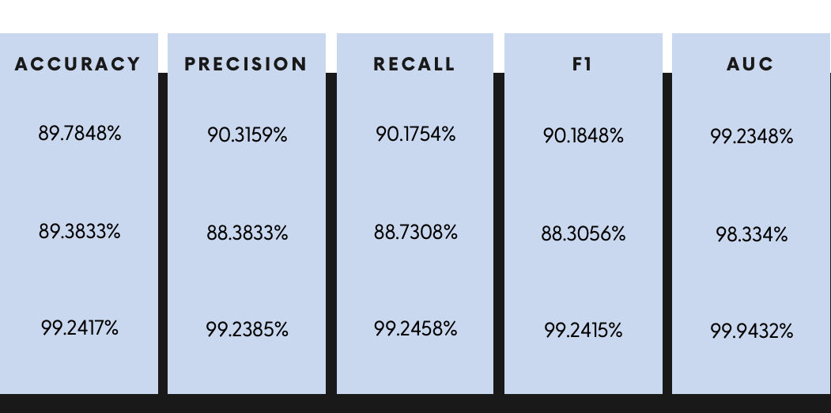
BASELINE
(Comparable Models)
XGBOOST
87%
78%
94%
91%
87%
79%
94%
90%
86%
74%
93%
90%
86%
75%
94%
90%
0.98
0.94
0.99
0.98
Random Forest
MLP
Logistic Regression

Slide 13
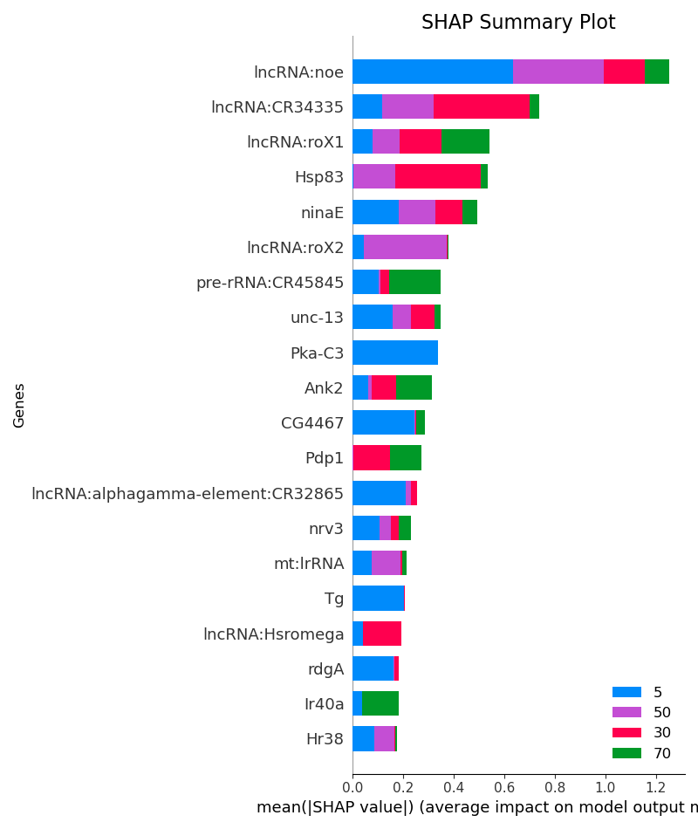
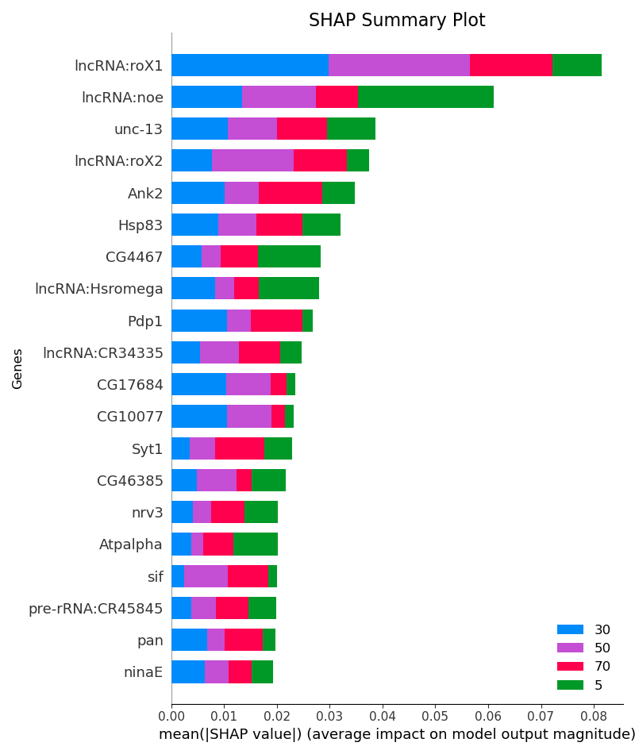
Baseline Models – All Cells (Head)
Figure 25 : XGBOOST Age SHAP Summary Plot
Figure 26: MLP Age SHAP Summary Plot

Slide 14
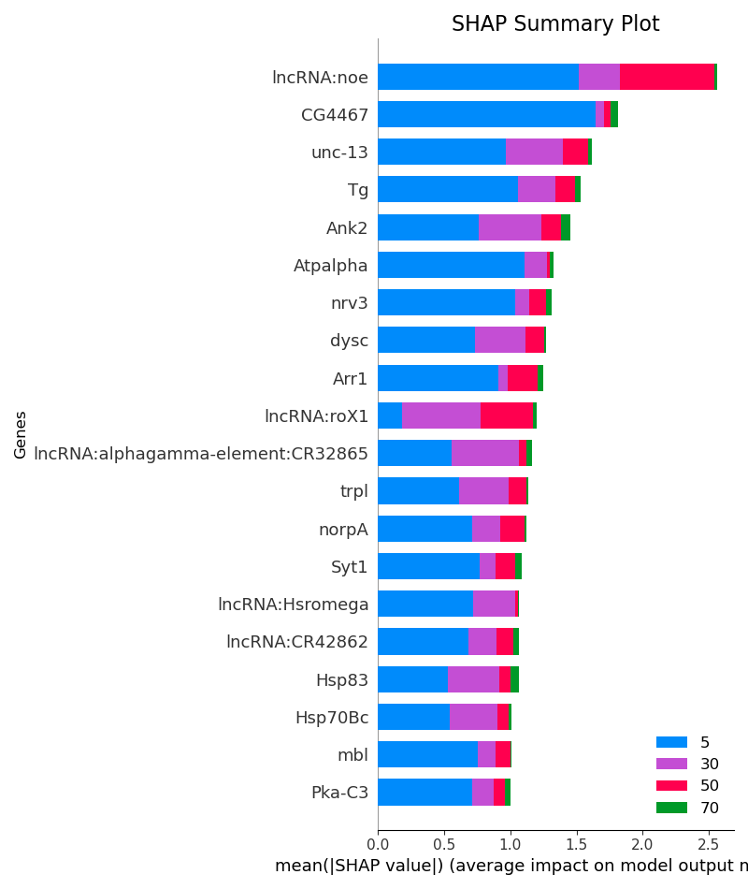
Baseline Models – All Cells (Head)
Figure 27: LR Age SHAP Summary Plot

Slide 15
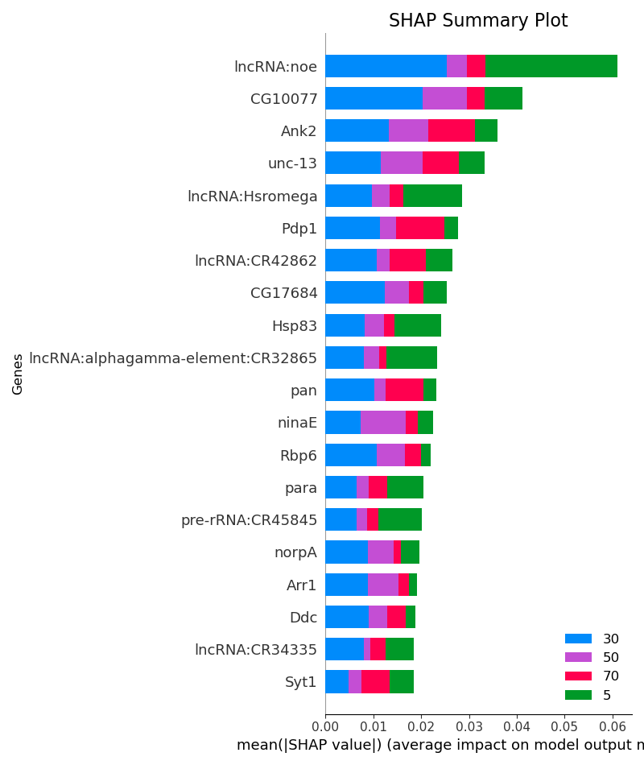
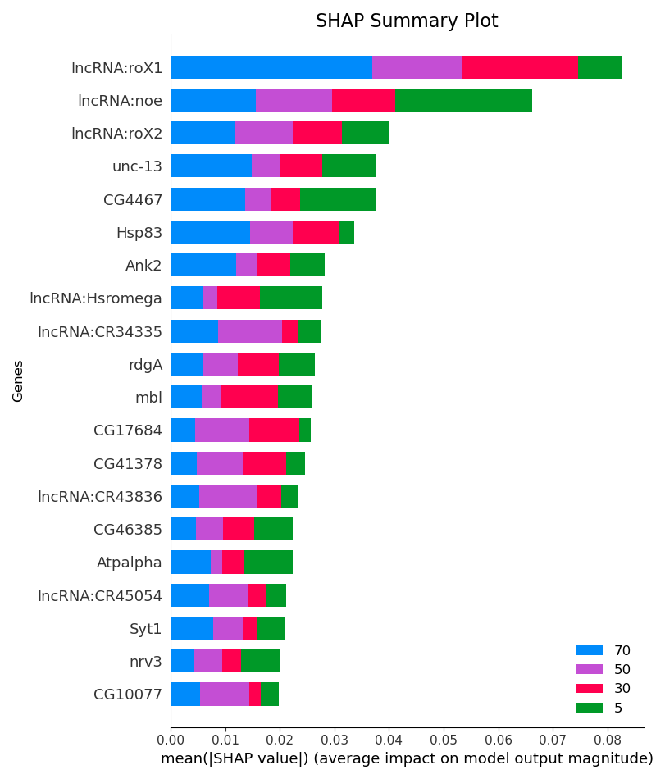
AGE – All Cell Types (Head): Same Sex Testing
Figure 28: Age SHAP Summary Plot – Train Male test female (ACC: 96%, AUC: 0.99)
Figure 29: Age SHAP Summary Plot – Train female test female (ACC: 93%, AUC: 0.99)

Slide 16
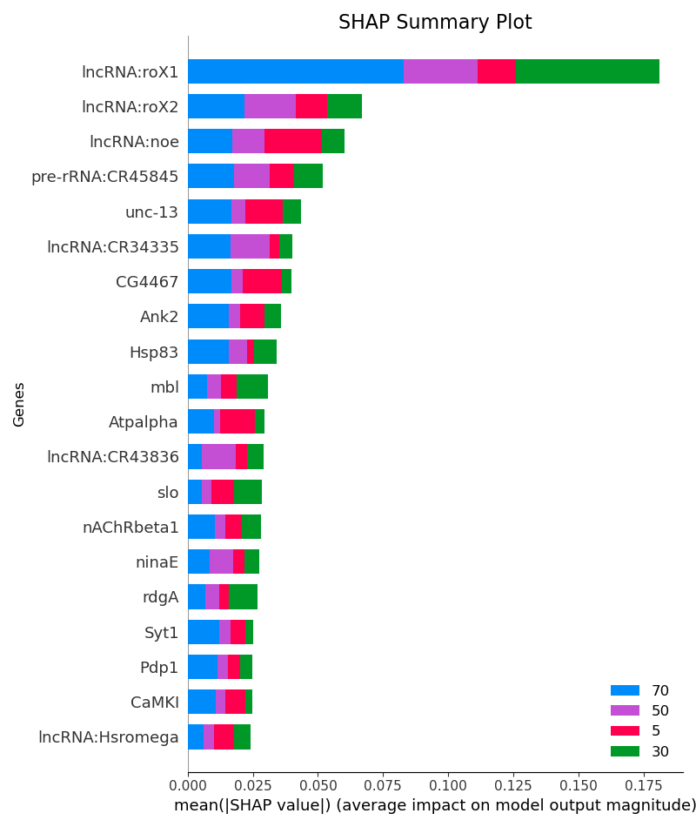
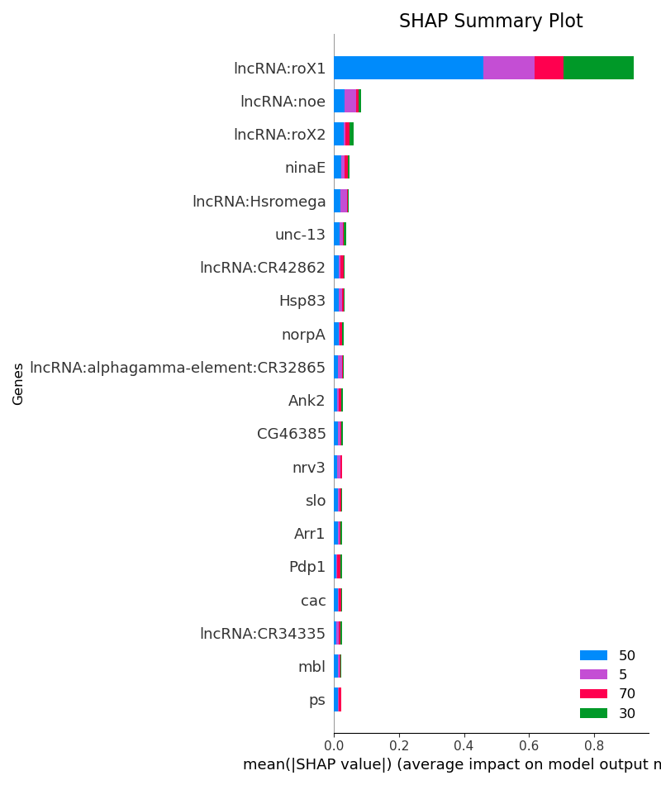
AGE – All Cell Types (Head): Opposite Sex Testing
Figure 30 : Age SHAP Summary Plot – Train Male test female (ACC: 68%, AUC: 0.90)
Figure 31 : Age SHAP Summary Plot – Train female test male (ACC: 60%, AUC: 0.77)

